Slide 1
Smarter Balanced Interim Assessments
December 15 2016
STB Year-End Staff Meeting
SB IA Overview
Your presenter: Chris Mullins
STB/Comprehensive Assessment Program

Slide 2
California Assessment of Student Performance and Progress System
CAASPP
Smarter Balanced Assessments
California Alternate Assessment (CAA)
California Science Test (CAST)
Pilot Test
3/20 – 6/last day of school
Summative Assessments
Standards-Based Test in Spanish (STS)
Interim Assessments
Digital Library
Interim Assessment Blocks (IAB)
Interim Comprehensive Assessments (ICA)

Slide 3
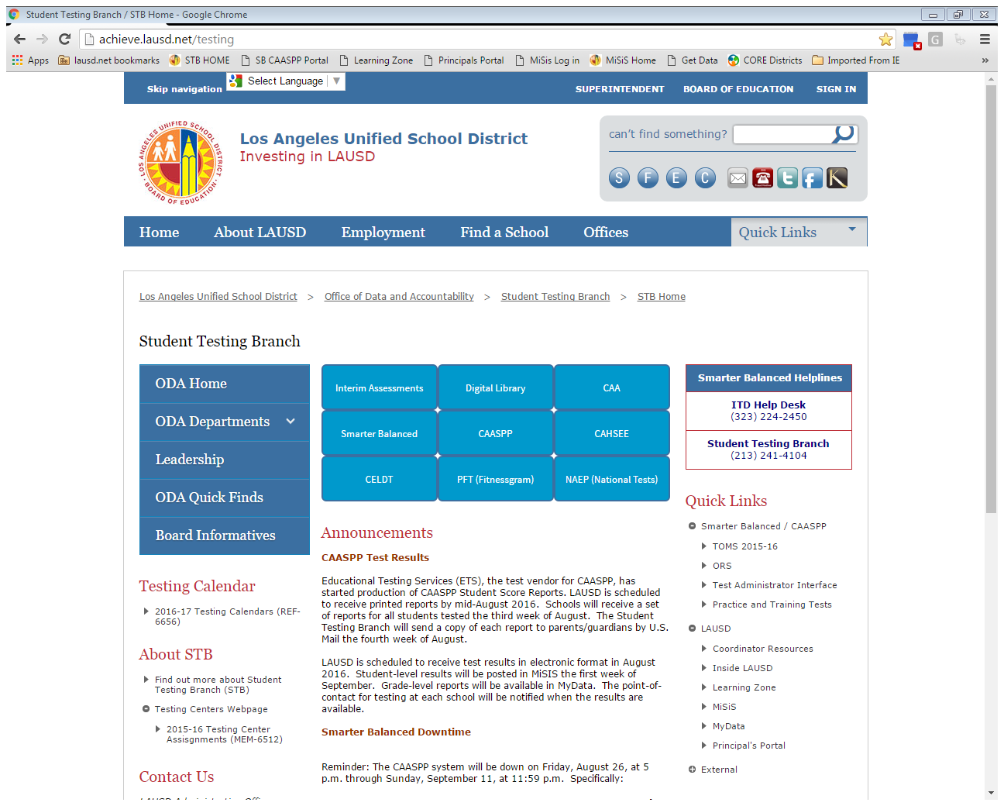
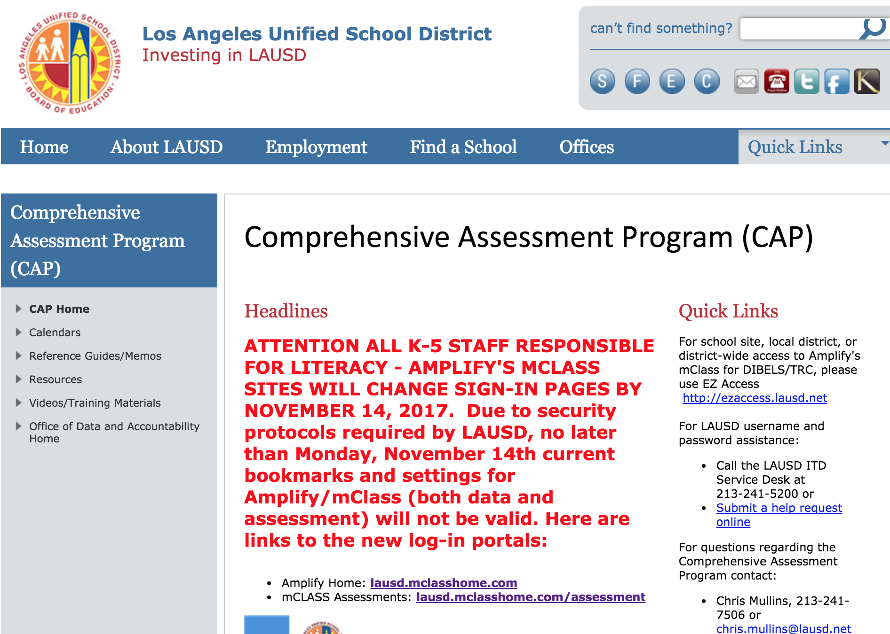
Critical Links: STB; CAASPP; CAP
 Best Practice
Bookmark these Webpages
Interim Assessment Tabs

Slide 4
Interim Assessment STB Year-End Overview
Agenda
Interim Assessment LAUSD Policy (MEM-6700.0)
Interim Assessment Purpose and Types
Smarter Balanced Interim Comprehensive Assessments (ICA)
Smarter Balanced Interim Assessment Blocks (IAB)
Interim Assessment Viewing System
Interim Assessment Hand Scoring
Interim Assessment Administration (including accommodations for Special Education)
Interim Assessment Reporting System
Interim Assessment General Information

Slide 5
LAUSD Interim Assessment Policy
MEM-6700 is the only policy document for 2016-2017 specific to the District’s required interim assessments. The body of the document is only 4 pages, and there are several attachments.
Chris Mullins – CAP Coordinator
213-241-7506
chris.mullins@lausd.net

Slide 6
SPOTLIGHT on MEM 6700
MEM 6700 is a Division of Instruction document
The Comprehensive Assessment Program and its Coordinator (Chris Mullins) are part of Student Testing Branch, Office of Data and Accountability.
DOI has stated that no updates to MEM 6700 will happen for the 2016-2017 school year.
DOI also states that the intention is to publish “MEM 6700.1” for the 2017-2018 school year before the 2016-2017 school year ends.
Phone numbers for DOI, Mathematics and Literacy/Language Arts (elementary and secondary) can be found on lausd.net under OFFICES

Slide 7
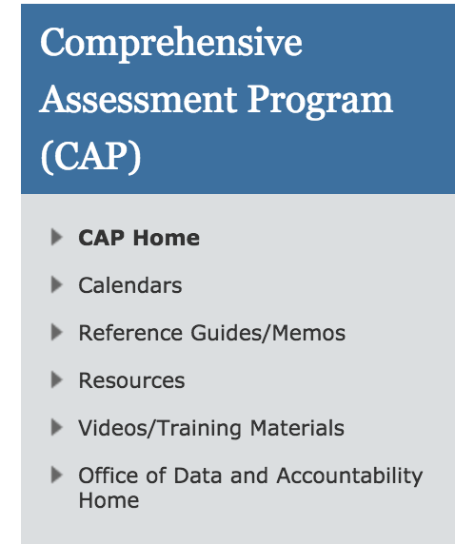
Link to MEM 6700 0n CAP homepage
To direct anyone seeking a link to MEM 6700, ask them to go to lausd.net and under OFFICES, click on Comprehensive Assessment Program
On the CAP homepage, they click on Ref Guides/Memos. Et voila! (French for, “If it were a snake…”)

Slide 8
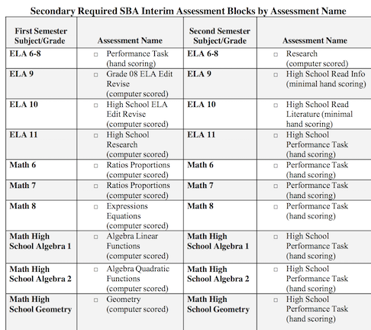
Attachments C & D of MEM 6700
Attachment D – Secondary required IAs
Attachment C – Elementary required IAs
For clarification on Math 8, fall, and ELA 10, fall, refer callers to the Testing Update, 10/21

Slide 9
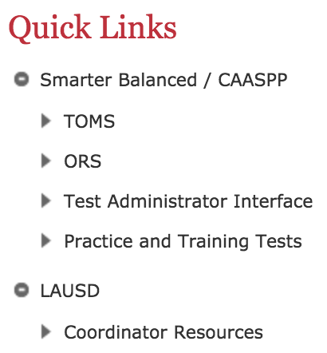
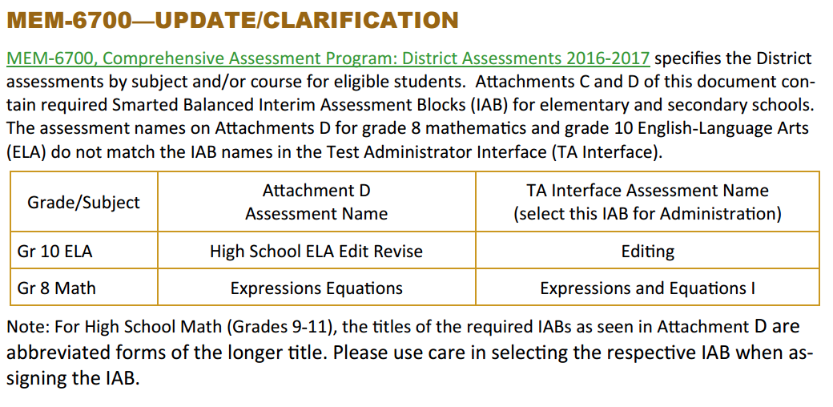
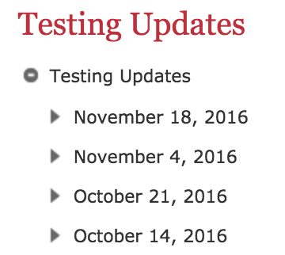
Testing Update, 10/21
Copies of all Testing Updates are available on STB homepage under Coordinator Resources

Slide 10
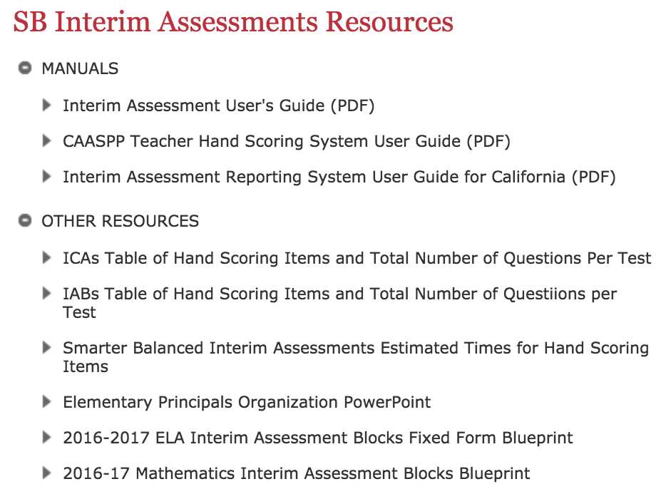
Other issues with Attachment D
In some cases, the IA name DOI uses is an abbreviation of a LONGER title seen on CAASPP/TOMS
This is true especially of the High School Math IABs
Direct any confused caller to the IAB Blueprints (links on STB Interim Assessment homepage). The Attachment IA name can be seen as part of the longer title on the Blueprint.
Or have the caller contact DOI, Secondary Mathematics

Slide 11
Interim Assessment Purpose and Types

Slide 12
Smarter Balanced Interim Assessments
Summative assessments
benchmarked to college and career readiness
(Grades 3-8 and 11)
Teachers and schools have information and tools to improve teaching and learning
Standards set
expectations on path to college and career readiness
All students graduate college and career ready
Digital Library: Formative assessment tools and practices
for teachers to improve instruction
Interim assessments Flexible, open, used for actionable feedback

Slide 13
Smarter Balanced Interim Assessment Blocks (IABs)
The following tables are intended to assist LEAs in planning for the administration and local hand scoring of the Interim Assessment Blocks (IAB). Included in each table are the total number of items on each IAB. The total number of items shown includes both machine scored and hand scored items. Each table also provides the number of constructed response and essay items that require local hand scoring.
The entire list of available IABs for grades
3-8 and 11 can be found at the following web link:
http://www.cde.ca.gov/ta/tg/ca/iabhandscoring.asp
OR…on the STB/IA page!

Slide 14
Interim Assessment Purpose
The Interim Assessments are one component of the Smarter Balance assessment system and are designed to support teaching and student learning throughout the year. The items are developed under the same conditions, protocols, and review procedures as those used in the summative assessments.

Slide 15
Interim Assessment Purpose cont.
The content of the tests has been aligned to the Common Core State Standards in grades 3–8 and high school. The grade level to assess should be based on the purpose of the testing event.
Each test can be administered to students in any grade (e.g., a grade 7 interim test is not limited to grade 7 students, but can be administered to students in grades 6 or 8).

Slide 16
Interim Assessment Types
Two types of interim assessments:
Interim Comprehensive Assessments (ICAs)*
English language arts/literacy (ELA) test and performance task
Mathematics test and performance task
*NOT REQUIRED
Interim Assessment Blocks (IABs)**
There are 5 and 17 IABs per grade and content area and 28 new and/or improved assessment blocks
**REQUIRED, Grades 3-11

Slide 17
Smarter Balanced Interim Comprehensive Assessments (ICA)
Fixed form
Use the same blueprints and assess the same standards as the summative assessments
Include the same item types and formats, including performance tasks, as the summative assessments
Yield overall scale scores, overall achievement level designations, and claim score information
Report against the same scale as the summative test

Slide 18
Smarter Balanced Interim Comprehensive Assessments (ICA)
Examples of the use of ICAs include:
A new student from another state is given the previous year’s ICA.
Mid-year a teacher gives an ICA to gauge how students might perform on the summative assessment.

Slide 19
Smarter Balanced Interim Assessment Blocks (IABs)
Fixed form
Focus on fewer sets of skills (e.g., Geometry)
Flexible; supports instruction and curriculum
Include the same item types and formats, including classroom activities and performance tasks, as the summative assessments
Yield overall information for each block
Results are reported as Below Standard, At/Near Standard, and Above Standard

Slide 20
Smarter Balanced Interim Assessment Blocks (IABs)
Examples of the use of IABs include:
A teacher uses the argument performance task to determine the degree of a student’s understanding before or after instruction.
A team of teachers uses a block to become informed about how a group of students are performing in geometry.

Slide 21
Smarter Balanced Interim Assessments What’s New
New and/or Improved Assessments
11 Math IABs
17 ELA IABs
Manner of Administration
Nonstandardized (default)
Standardized/Benchmark

Slide 22
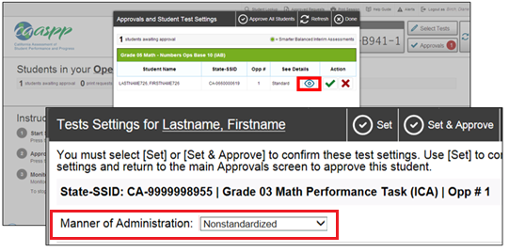
Smarter Balanced Interim Assessments What’s New
Manner of Administration
The Manner of Administration setting, new for the 2016-2017 administration, is used to indicate whether or not an administration of the interim assessments will be standardized. This setting is available for use when administering both ICAs and IABs.
Note: The Manner of Administration setting is used to indicate the results to be
maintained in the IA Reporting System for potential local longitudinal analyses.
To view and set the manner of administration, select the [View] icon ( ) to display the student Test Settings screen (Figure 27).

Slide 23
Interim Assessment Viewing System

Slide 24
Interim Assessment Viewing System
All Smarter Balanced Interim Assessment Resources are governed by the following 2 guidelines
Not secure, but not public
Limited access to only those individuals within the District who have a professional interest in the use of the assessments and their resources

Slide 25
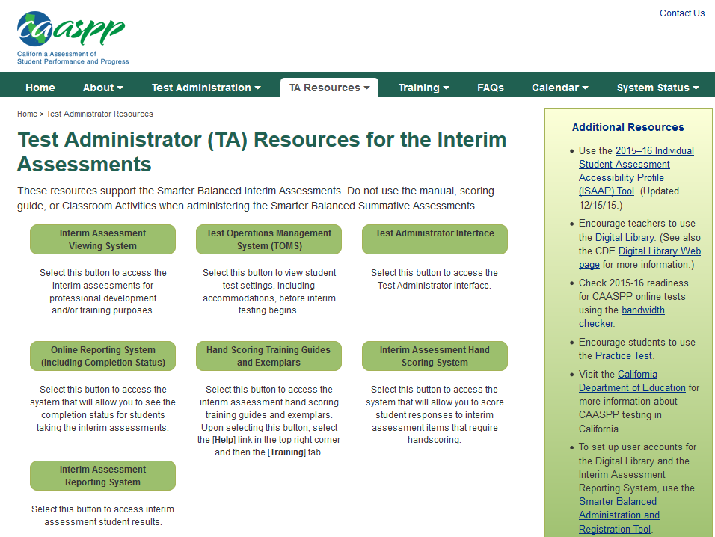
Interim Assessment Viewing System
Teacher View enhancement is available for TOMS account holders to use for planning and or training purposes
Is accessible through the caaspp.org website

Slide 26
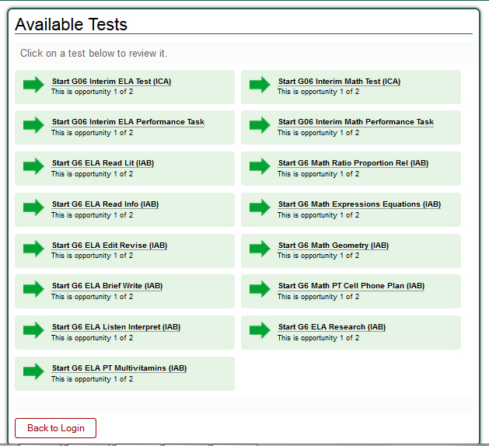
Preview the Tests

Slide 27
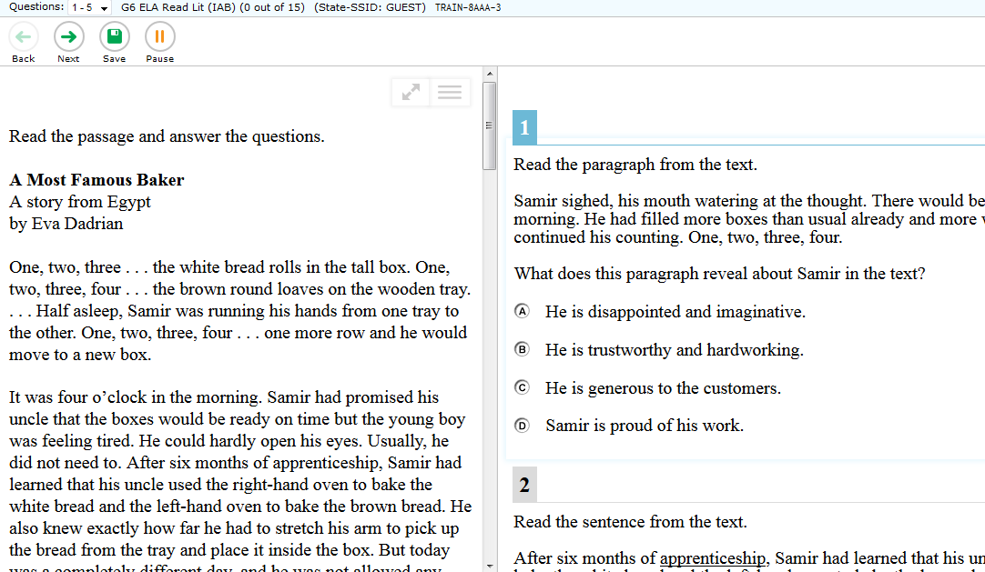
Preview the Tests cont..

Slide 28
Interim Assessment Hand Scoring

Slide 29
Interim Assessment Hand Scoring
Most interim assessment items are scored by the Smarter Balanced test delivery engine.
Hand scoring of constructed-response items and performance tasks is a local responsibility.
Results for individual students are generated only after the constructed-response item scores and performance task scores are inputted into the Interim Assessment Hand Scoring System (IAHSS). (Processing time of up to 48 hours)
Scoring is supported by training guides, rubrics, exemplars (i.e., anchor and practice papers).

Slide 30
Training Guides and Exemplars
Training Guides and Exemplars for all constructed response items and performance tasks are accessible in TOMS.
Schools can access these secure materials for professional development and training purposes.

Slide 31
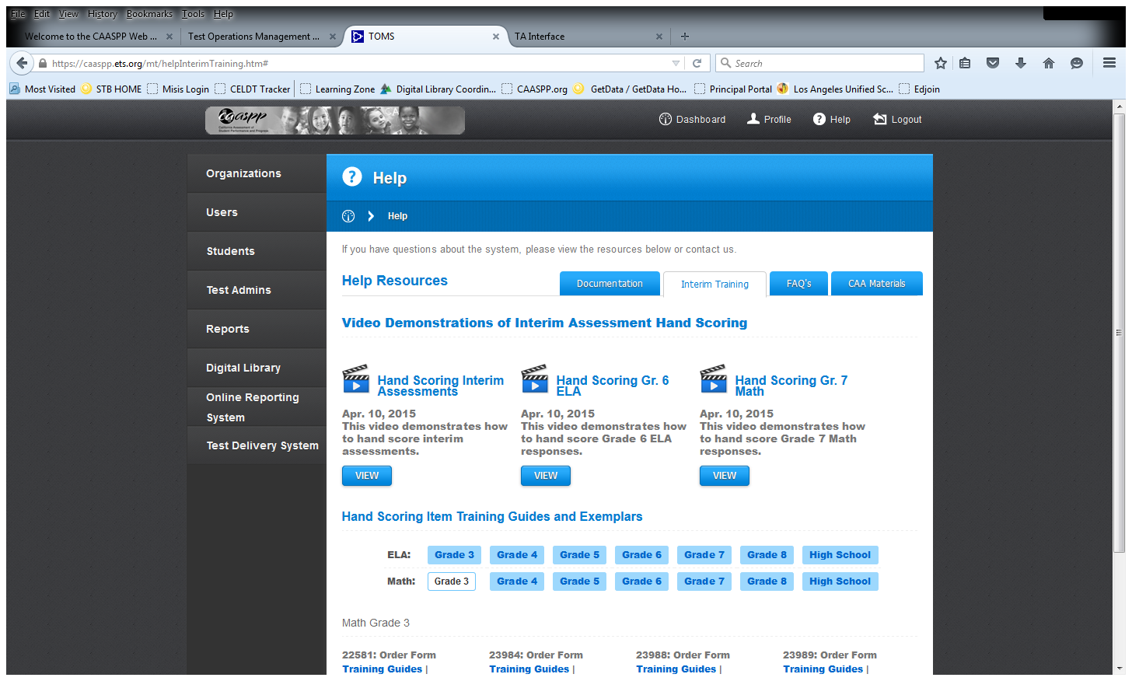
Videos, Training Guides and Exemplars

Slide 32
Scoring Training Guides

Slide 33
Scoring Exemplars

Slide 34
Scoring Exemplars

Slide 35
Interim Assessment Scoring Logging In…
The Interim Hand Scoring System is part of the connected suite of Single Sign-On systems (e.g., TOMS, TA Interface, Completion Reports, etc.)
2
1

Slide 36
Hand Scoring System Home Page
Notes:
Once you log in to the interim assessment hand scoring system, the home page or the page you land on is called the Response List and it looks like this. Your Response List can be many pages long depending on how many tests have been administered and how many student responses are in the system that require local scoring.

Slide 37
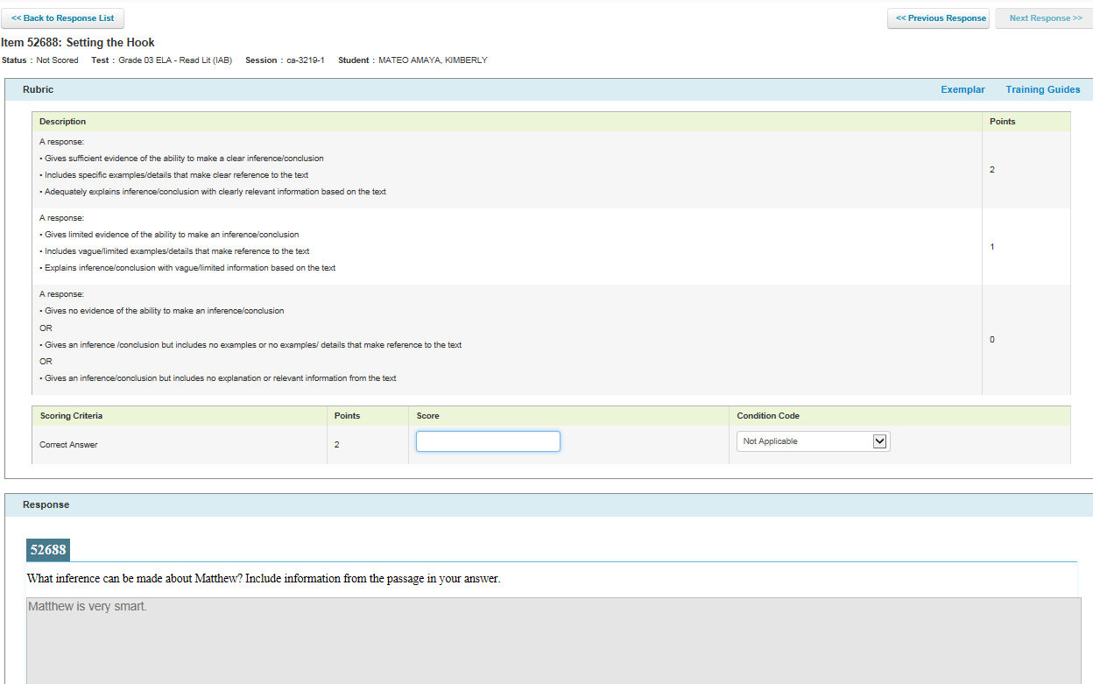
Scoring Responses
Notes:
Once you select the Score button to the right of a response, the system will take you to the scoring screen which looks like this. At the top of the screen, and not visible here, is the status of the item (scored, tentatively scored), session ID, student name, etc. Then you see the rubric and number of points possible, and boxes to insert scores or a pull-down menu to select one of the condition codes. On this same screen toward the bottom of the page, although not visible here, you can see the prompt and the student response. Please note the link to Exemplar and Training Guides. We’re going to come back to these in just a few minutes, but note that for every item, you are provided with exemplars and a training guide which can be downloaded and printed to support with the scoring.

Slide 38
Scoring Responses cont.
Notes:
Here is a snapshot of where the Exemplars and Training Guides are located. If you select either of these links, you can download the document. You can also print them for use in preparing for scoring or for use in a more collaborative training for scoring.
Every effort was made to make sure these materials are consistent across subjects, grades, and item types. The materials are designed to be teacher-friendly. These materials can also be downloaded and used in a facilitated professional development opportunity with LEA CAASPP coordinators, site coordinators, or test administrators, who have all signed the required security agreements or affidavits.

Slide 39
Interim Assessment Administration: Accessibility and Accommodations

Slide 40
Universal Tools, Designated Supports and Accommodations
REF-6420.2 published 12/8/2016!
Universal Tools
Can be provided to any student and are available either an embedded tool (contained within the computer testing program) or as a non-embedded tool (student uses a tangible tool such as a Thesaurus or paper dictionary).
Designated Supports
Must be designated prior to the first day of testing window
Available to ELs for whom the need has been indicated
Decision made by educators familiar with the student’s characteristics and needs
Supports the student has been using during instruction/assessments
Non-embedded supports are to be provided by the school
ELs with disabilities should have the Designated Supports and Accommodations listed on the IEP or Section 504 Plan.
Accommodations
Must always be indicated in a student’s IEP or Section 504 Plan

Slide 41
Information re Accessibility and Accommodations on CAP pages
The CAP Reference Guides/Memos page has a link to a copy of 6420.2
There is also a separate document specific to the required SB IAs, called ‘Guidelines” and produced by the Department of Special Education. The link is under RESOURCES.

Slide 42
A Highlight of the “Guidelines” document
The following is the essential statement re the SB IAs and SE students:
Students with disabilities on the general education curriculum (core curriculum) will participate in the Interim Assessment Blocks (IABs) or the school-selected alternative assessment using any Designated Supports and/or Accommodations specified on the Individualized Education Program (IEP). Schools must ensure all students with disabilities have access to those supports and/or accommodations during all IABs, including those developed locally.

Slide 43
Universal Tools
Universal Tools
Available to ALL students
Embedded
Breaks, Calculator, Digital Notepad, English Dictionary, English Glossary, Expandable Passages, Global Notes, Highlighter, Keyboard Navigation, Mark for Review, Math Tools, Spell Check, Strikethrough, Writing Tools, Zoom
Non-Embedded
Breaks, English Dictionary, Scratch Paper, Thesaurus

Slide 44
Designated Supports
Designated Supports
Must be set in TOMS
Available for all students for whom the need has been documented
Embedded
Color Contrast, Masking, Text-to-speech, Translated Test Directions (Glossary), Translations (Stacked), Turn off Any Universal Tools
Non-Embedded
Bilingual Dictionary, Color Contrast, Color Overlay, Magnification, Read Aloud, Scribe, Separate Setting, Translated Test Directions, Translation (Glossary)

Slide 45
Purpose and Importance of Designated Supports
Equal opportunity to demonstrate learning
Access to CAASPP assessments
Facilitate participation in classroom assessments
Accuracy and validity of test results
Standardization and consistency of test administration procedures across Consortium states through:
Alignment with Smarter Balanced policies
Alignment with California laws and regulations

Slide 46
Documentation for Designated Supports and Accommodations
Designated supports and Accommodations must be documented
Attachments should be completed/approved by decision-making teams/designees (e.g.)
Individualized Education Program (IEP) teams
Section 504 Plan teams
Teacher of EL student, and
Language Appraisal Team (LAT), and/or
Student Success Teams (SST), or
Coordination of Services Team (COST)

Slide 47
REF-6420.1 Accessibility Attachment A Designated Supports
Notes:
Try to break up into two slides

Slide 48
REF-6420.1 Accessibility Attachment B Designated Supports
Notes:
Try to break up into two slides

Slide 49
Accessibility Features
When should settings be entered in TOMS?
Before students take Smarter Balanced assessments.
Test settings are entered by the CAASPP Test Site Coordinator (SC)
When using their own credentials, students will be able to use their designated settings when accessing:
Practice and Training Tests
Smarter Balanced Summative Assessment
Smarter Balanced Interim Assessments
 Best Practice
Allow students to practice using their assigned supports

Slide 50
Accessibility Features
General guidelines for use of all accessibility features:
Student is familiar with the support(s)
Supports are same or similar to those used for instruction and classroom assessment
Student has multiple opportunities to practice in test environment

Slide 51
Sample Designated Support for
EL Student
TRANSLATIONS (STACKED)

Slide 52
Implementation of
Designated Support for all Students
Access Summative
Assessments
Access Interim
Assessments
Identify student needs
Match
needs to
available supports
Enter supports into TOMS
Use supports at classroom level
Use Interim Assessments Practice Tests and Training Tests
Finalize support selections
Evaluate effectiveness
of supports

Slide 53
Accommodations
CAASPP Matrix One
The California Department of Education’s Web page displaying the universal tools, designated supports, and accommodations (embedded and non-embedded) allowed as part of CAASPP for 2015–16
Accommodations
Must be set in TOMS every year
Available for all students as indicated in their IEP or Section 504 Plan

Slide 54
Accommodations cont.
Smarter Balanced Assessments:
Welligent Section K Roster
CAASPP Coordinator will receive from:
Elementary: APEIS
Secondary Schools: Special Education Administrator/Designee
California Alternate Assessment (CAA)
List of Accommodations for each CAA student
FAPE Part 1

Slide 55
Interim Assessment Reporting System

Slide 56
Interim Assessment Reporting System cont.…
Teachers will use their Digital Library logon credentials to access the Data Warehouse to view Interim Assessment student reports.
2
1
Requires same logon credentials used for the Digital Library
3

Slide 57
Interim Assessment Reporting System Results
Reports for lists of students and individual student reports. No aggregate reports.
ICA: Overall scale score (i.e., 2000 to 3000); Achievement Level (Level 1, 2, 3, or 4); and Claim level (Below, At/Near, or Above Standard).
IAB: Level of Below, At/Near, or Above Standard for each Block.
Exportable data file.

Slide 58
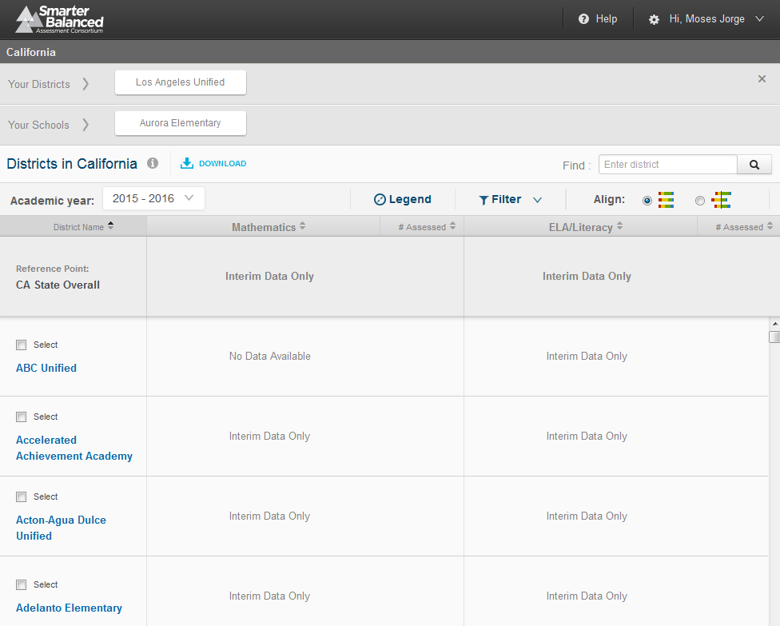
IA Reporting System Home Page
Your School
List of Districts
Notes:
Once you log in to the Interim Assessment Reporting System, this is the landing or home page.
All the LEAs in California are listed on this page. You can use the search box, here to the upper right, to more quickly find your LEA instead of scrolling through the list of districts, which is displayed on the left.
However, one can only access data for their own LEA. Notice everything is grayed out and the words “Interim Data Only” or “No Data Available” are visible here. It is only when you go to your own LEA, and select the name of your LEA that you will navigate to a screen where you can see your results.

Slide 59
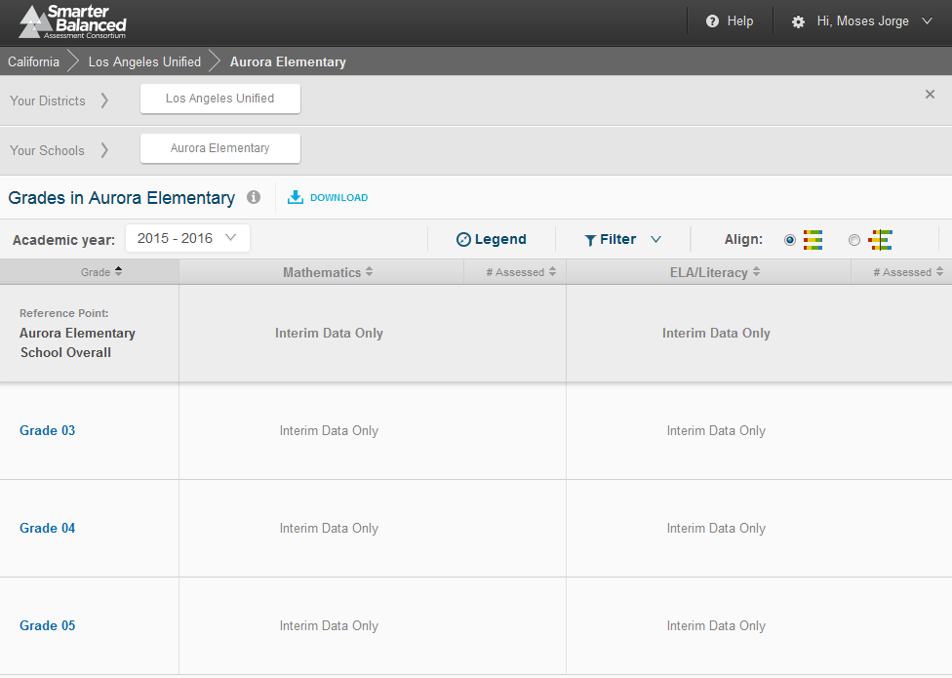
IA Reporting System Home Page
Notes:
Once you log in to the Interim Assessment Reporting System, this is the landing or home page.
All the LEAs in California are listed on this page. You can use the search box, here to the upper right, to more quickly find your LEA instead of scrolling through the list of districts, which is displayed on the left.
However, one can only access data for their own LEA. Notice everything is grayed out and the words “Interim Data Only” or “No Data Available” are visible here. It is only when you go to your own LEA, and select the name of your LEA that you will navigate to a screen where you can see your results.

Slide 60
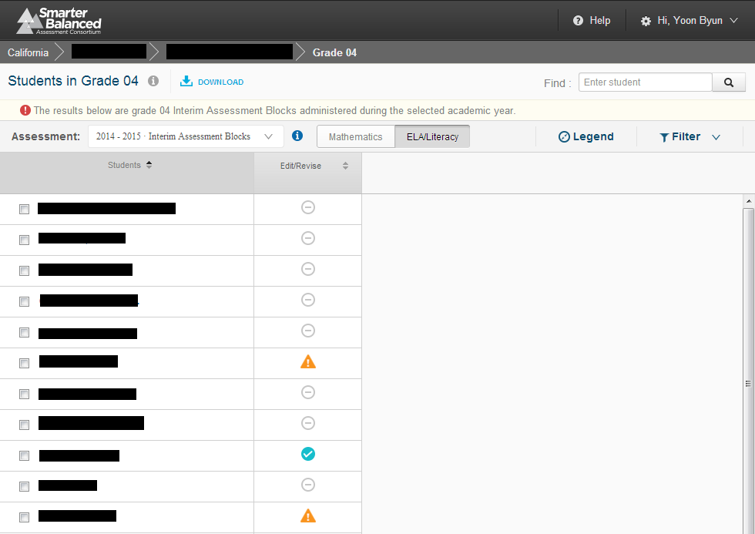
Interim Assessment Block List of Students

Slide 61
“List of Students” Display
Presents the following information listed by individual student name:
Individual results for students within grade or subgroup.
Overall scores, achievement levels, and error bands for individual student performance (ICA only).
Overall individual student performance by claim (ICA) or block (IAB).

Slide 62
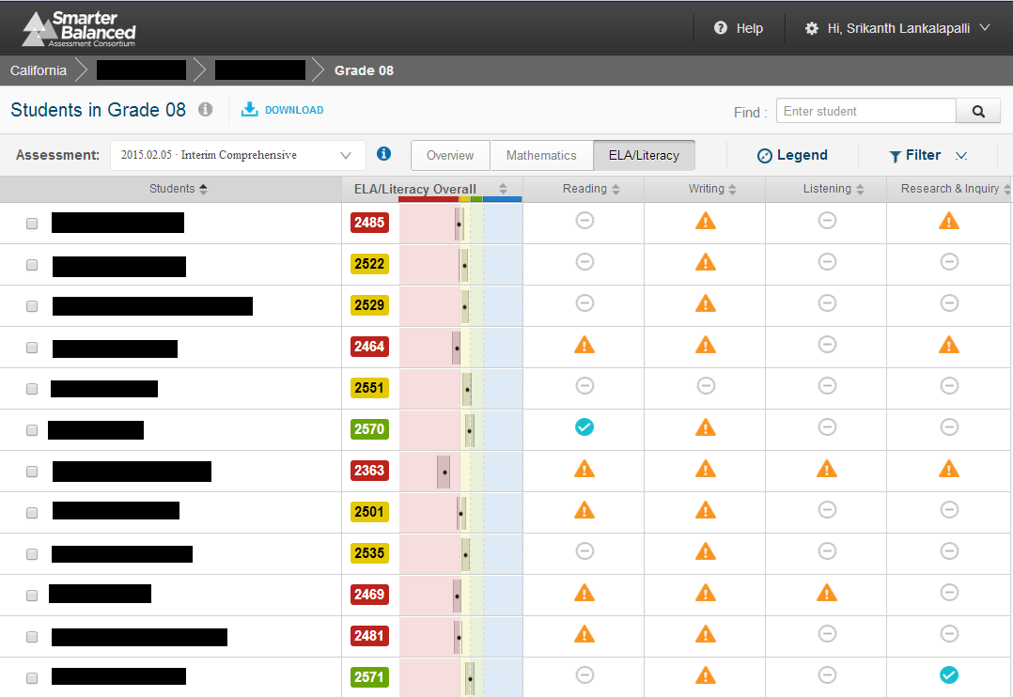
Interim Comprehensive Assessment List of Students

Slide 63
Interim Assessment General Information

Slide 64
Interim Assessment General Information
Technology Updates
As of November 14, Secure Browsers need to be upgraded to new Air Secure Browser v.9
All testing device carts should be opened, devices accounted for (including keyboards) and charged
For technical assistance or issues with testing devices or infrastructure, email or contact:
ITD Hotline - (213) 241-5200
For trouble calls
Joe Oliver, Director Information Technology Division 213-241-3837 @ joe.oliver@lausd.net
For assistance with Testing Device Carts or inventory of Testing Devices

Slide 65
Interim Assessment General Information
Schools will receive earphones to accommodate their student enrollment in grades 3-8 and 11.
More details forthcoming!

Slide 66
Interim Assessment General Information
Smarter Balanced Interim Assessments | Interim Assessment Viewing System | TOMS | Test Administrator Interface | Interim Assessment Hand Scoring System | Interim Assessment Reporting System
Primary Use | Select to access interim assessments for professional development and/or training purposes. | Select to access video demonstrations of interim assessment hand scoring. It includes Training Guides and Exemplars. | Select to start a test session, add tests to the session, verify students’ test settings, approve students for testing, and monitor their progress. | Select to access Interim Assessment Hand Scoring System to score Smarter Balanced Interim assessment responses that require human scoring. | Select to view interim assessment results for tests that have been scored (all required computer-scored and human-scored items must be completed).
Log-in Credentials Needed | TOMS Credentials | TOMS Credentials | TOMS Credentials | TOMS Credentials | Digital Library Credentials
Who creates new teacher accounts and reset teacher passwords? | CAASPP school coordinator in TOMS Instructions: TOMS: Adding and Managing Users | CAASPP school coordinator in TOMS Instructions: TOMS: Adding and Managing Users | CAASPP school coordinator in TOMS Instructions: TOMS: Adding and Managing Users | CAASPP school coordinator in TOMS Instructions: TOMS: Adding and Managing Users | CAASPP school coordinator in Digital Library Instructions: SBAC Administration and Registration Tools User Guide
Manuals and User Guides | n/a | TOMS: Test Administration Setup Guide | Administration of the Online Interim Tests Resource Guide | Interim Assessment Hand Scoring System User Guide | Interim Assessment Reporting System User Guide
Other Resources |  |  |  | ICA number of items and hand scoring requirements IAB number of items and hand scoring requirements | Interim Assessment Reporting System Quick Start Guide

Slide 67
For More Information
CDE Interim Assessments Web Page
http://www.cde.ca.gov/ta/tg/sa/sbacinterimassess.asp
ETS CAASPP Web Site
http://www.caaspp.org
Student Testing Branch
http://achieve.lausd.net/testing
213-241-4104
Division of Instruction
http://achieve.lausd.net/instruction#spn-content
213-241-5333
Division of Special Education
http://achieve.lausd.net/sped
213-241-6701
ITD
http://achieve.lausd.net/Page/11176
213-241-5200
Comprehensive Assessment Program Coordinator
Chris Mullins
http://achieve.lausd.net/cap
213-241-7506

